Slide 1


Global Electricity Consumption
Seth Harris, Joaquin Ramirez, Leo Salazar, Collin Real
DA 6233.902 – Data Analytics Visualization & Communication
Fall 2023

Slide 2
Overview
Introduction
Global Consumption Over Time
Highest Energy Consumers
Distribution Losses
Imports/Exports
Conclusion

Slide 3

Introduction
Energy is the ultimate form of currency
Energy consumption is an economic indicator
Current dependence on scarce resources
Climate change policies
Key stakeholders

Slide 4
Population Growth
Economic Growth
Rising Living Standards
Urbanization
Energy-Intensive Industries
Transportation demands
Inefficient Energy Practices
Global Consumption

Slide 5
Energy Consumption by Region

Slide 6
Energy Consumption by Country
China
United States

Slide 7
% Change – 1980 vs. 2021

Slide 8
Distribution Losses

Slide 9
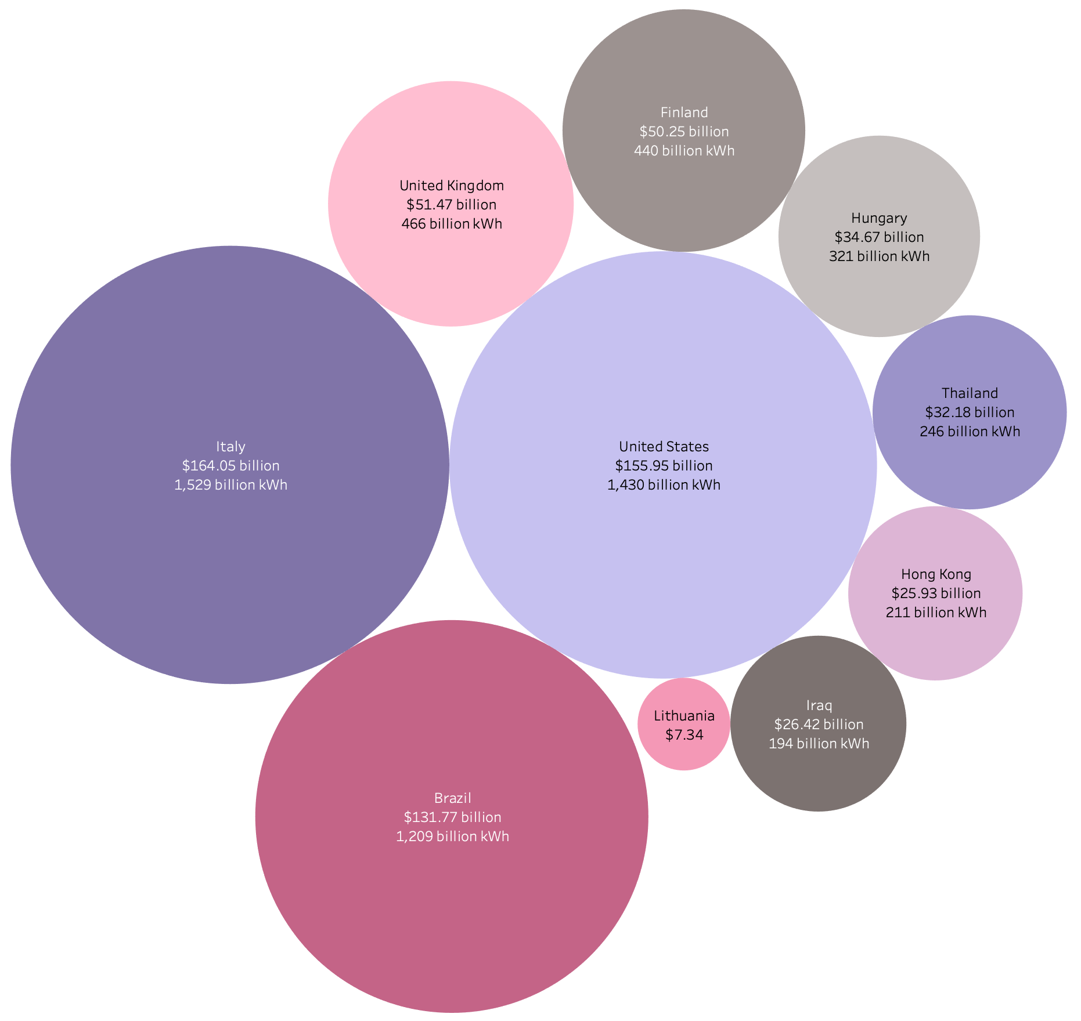
Net Imports

Slide 10
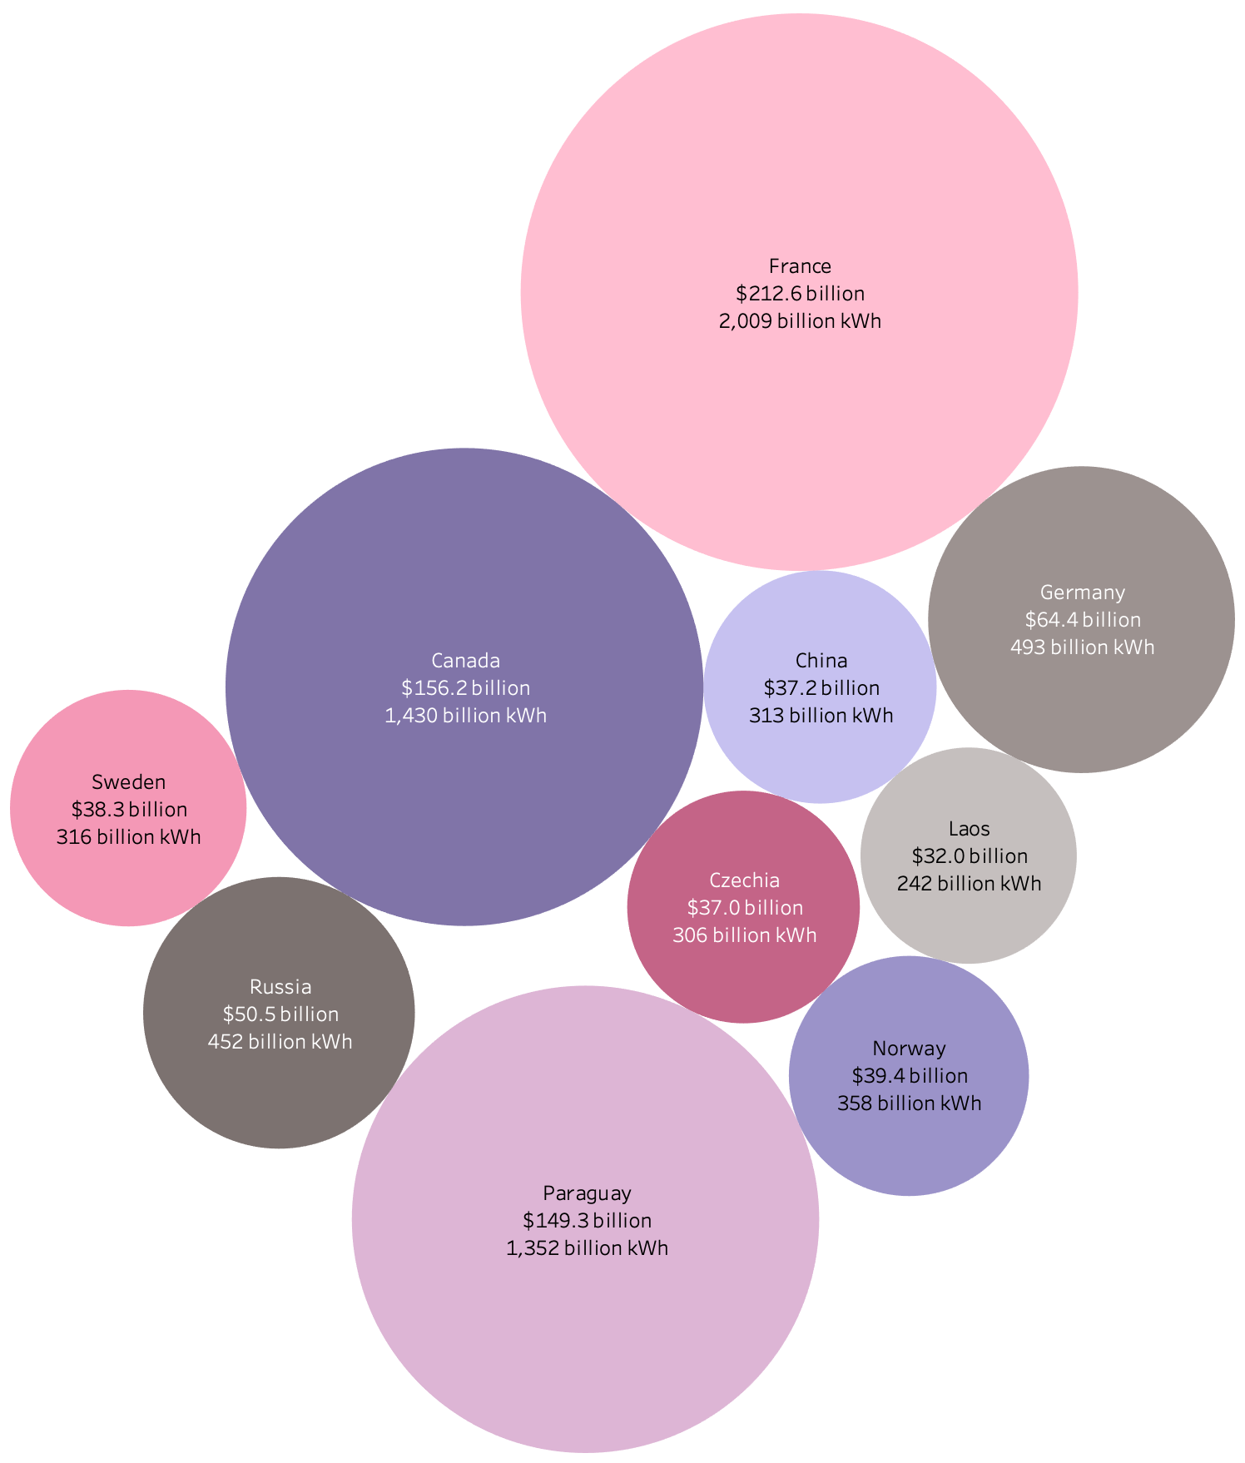
Net Exports

Slide 11
Conclusion

